Slide 1
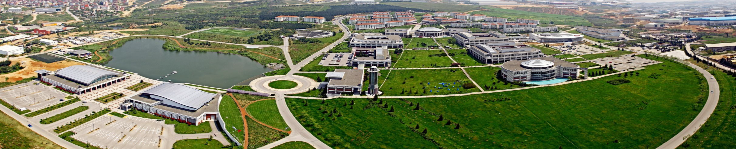
DA592 - Term Project Proposal
May 28,2017

Slide 2

Overview
01
Summary
02
Motivation
03
Project Description
04
Methodology
05
Deliverables
Görsel değişecek (Pınar Altınok)
06
Milestones
2

Slide 3

Log Anomaly Detection on Streaming Data
Summary
01
Title: Log Anomaly Detection on Streaming Data
Start Date: Jun 02, 2017
Finish Date: Sep 22, 2017
Project Team:
Emre Yazıcı
Özkan Öncü
Uğur Üker
3

Slide 4

Log Anomaly Detection on Streaming Data
Motivation
02
In a large environment the sheer volume of log files and events present issues and anomalies; many gigabytes of logs could be generated each day from one system alone, and thus manually reviewing log files is not only an inefficient method of review, it is also impractical. In addition, in a critical environment, some issues and anomalies must be detected whenever it happens to take immediate actions. Therefore, we would like to focus on this problem and develop a log file anomaly detector which work on streaming data. We anticipate that the application we will develop can be an alternative solution in the market against the problem.
4

Slide 5

Log Anomaly Detection on Streaming Data
Project Description
03
It is well-known that most of corporations have very complex
environment with many IT systems and IT services. Business continuity
depends on keeping those systems and services up all the time. It also
requires secure, reliable, and fast systems and services. Each system and
service has its own pattern of activity. All those activities generate large
log files every day. Monitoring and tracking the log messages are vital to
provide secure, reliable and fast environment. The aim of this project is to
develop an UX based application which will cluster log messages as soon
as they occurs and to detect anomalies in streaming log messages
immediately to warn administrator of systems and services.
5

Slide 6
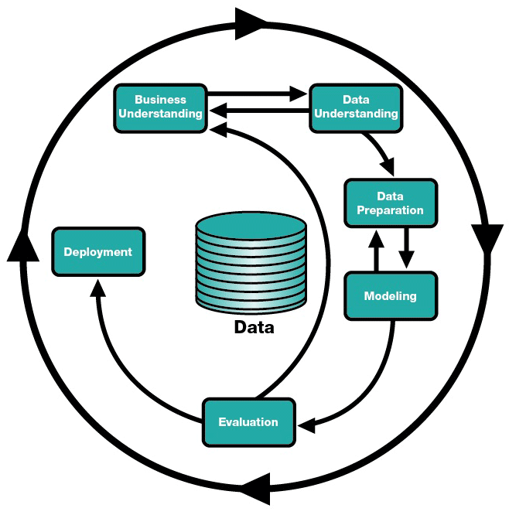

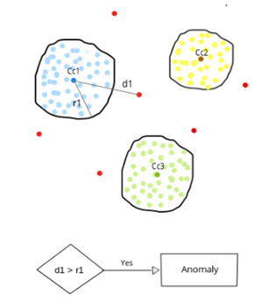



Log Anomaly Detection in Streaming Data
Methodology
04
We follow CRISP – DM steps along project lifecycle and intend to use
adaptive DBScan algorithm for clustering and to detect anomalies in
streaming data. We will collect and analyze data by using Python with
Apache Spark & Apache Kafka frameworks. We will probably store cluster
information in MongoDB . In addition, we will apply UX Design
standarts to have a easy-to-use product.
6

Slide 7
Log Anomaly Detection on Streaming Data
Deliverables
05
Project Plan & Deliverable List & Milestones May 25
Scope Document & Literature Review Results Jun 8
Analysis & Design Documents Jun 20
Initial Prototype Jun 30
Test Results Aug 25
User Guides, Final Report & Presentation Sep 15
7

Slide 8
Log Anomaly Detection on Streaming Data
Milestones
06
Start Date - Finish Date
Status
Problem Definition & Kick-off Meeting May 25 – May 25 Completed
Requirement Definition & Literature Review May 28 – Jun 08 In Progress
Requirement Analysis Jun 09 – Jun 20 Not Started
Algorithm Customization Jun 15 – Jun 20 Not Started
Creating a Prototype Jun 20 – Jun 30 Not Started
Development Jul 01 – Aug 10 Not Started
Testing Aug 10 – Aug 25 Not Started
Deployment Aug 25 – Aug 31 Not Started
User Guides,Presentation & Report Completion Aug 31 – Sep 15 Not Started
Project Closure Sep 15 – Sep 22 Not Started
8

